Slide 1

Biodiversity Analysis and Conservation
Addressing Biodiversity Loss in National Parks

Slide 2
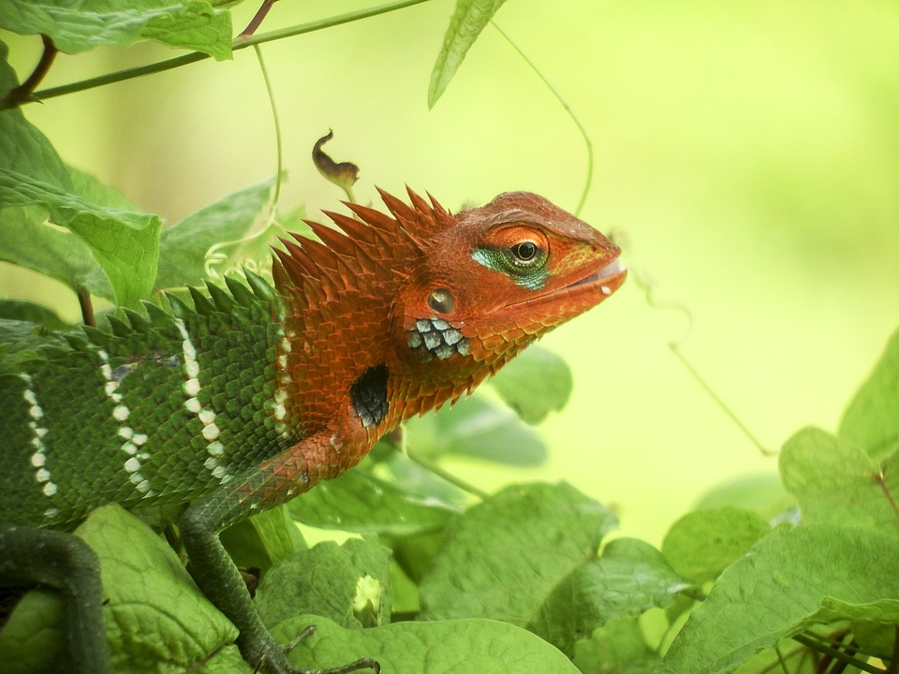
CONTEXT
Introduction
Data Overview
Conservation Recommendations
Summary

Slide 3
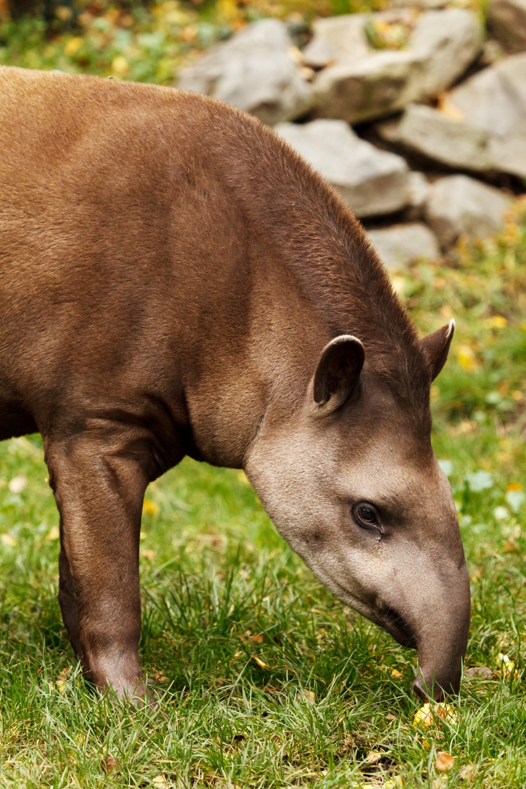
Introduction
This project focuses on the analysis and conservation of biodiversity within national parks.
Biodiversity is crucial for maintaining healthy ecosystems, supporting wildlife, and sustaining local communities.
National parks are often rich in species diversity but face challenges due to habitat loss, climate change, and human activities.
This project aims to address these challenges through comprehensive data analysis and targeted conservation efforts.

Slide 4
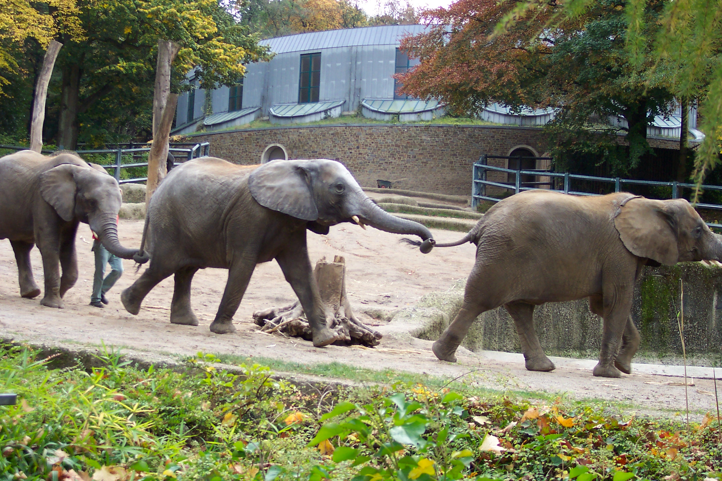
Data Overview

Slide 5
Data: species_info.csv
Overview:
The dataset 'species_info.csv' contains information about species populations within national parks.
Key observations include:
- Species names and classifications
- Population counts and distribution across different parks
- Notable trends such as declining or increasing species populations
- Patterns related to habitat conditions and environmental factors
Insights
Visual representations of species distribution show varying densities and populations across national parks.
Significant findings include:
- Areas with high species diversity versus those with low diversity
- Trends indicating potential threats or improvements in species populations
- Relationships between species distribution and habitat quality

Slide 6
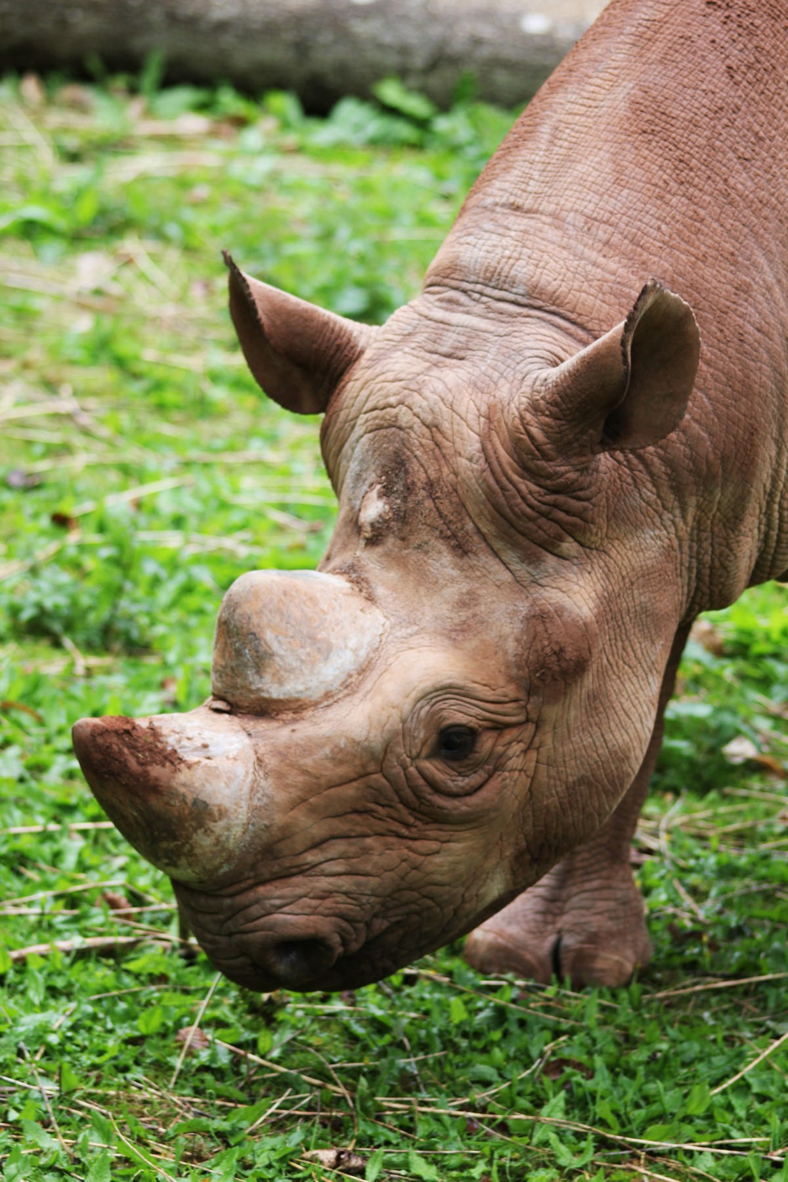
Conservation Recommendations
Based on significance calculations, the following recommendations are proposed:
Habitat Restoration: Focus on areas identified as having poor habitat quality.
Species Protection: Implement measures for species that are critically endangered.
Community Engagement: Develop programs to educate local communities about conservation and involve them in monitoring efforts.
Expected impacts include improved species diversity, healthier ecosystems, and increased community awareness.

Slide 7

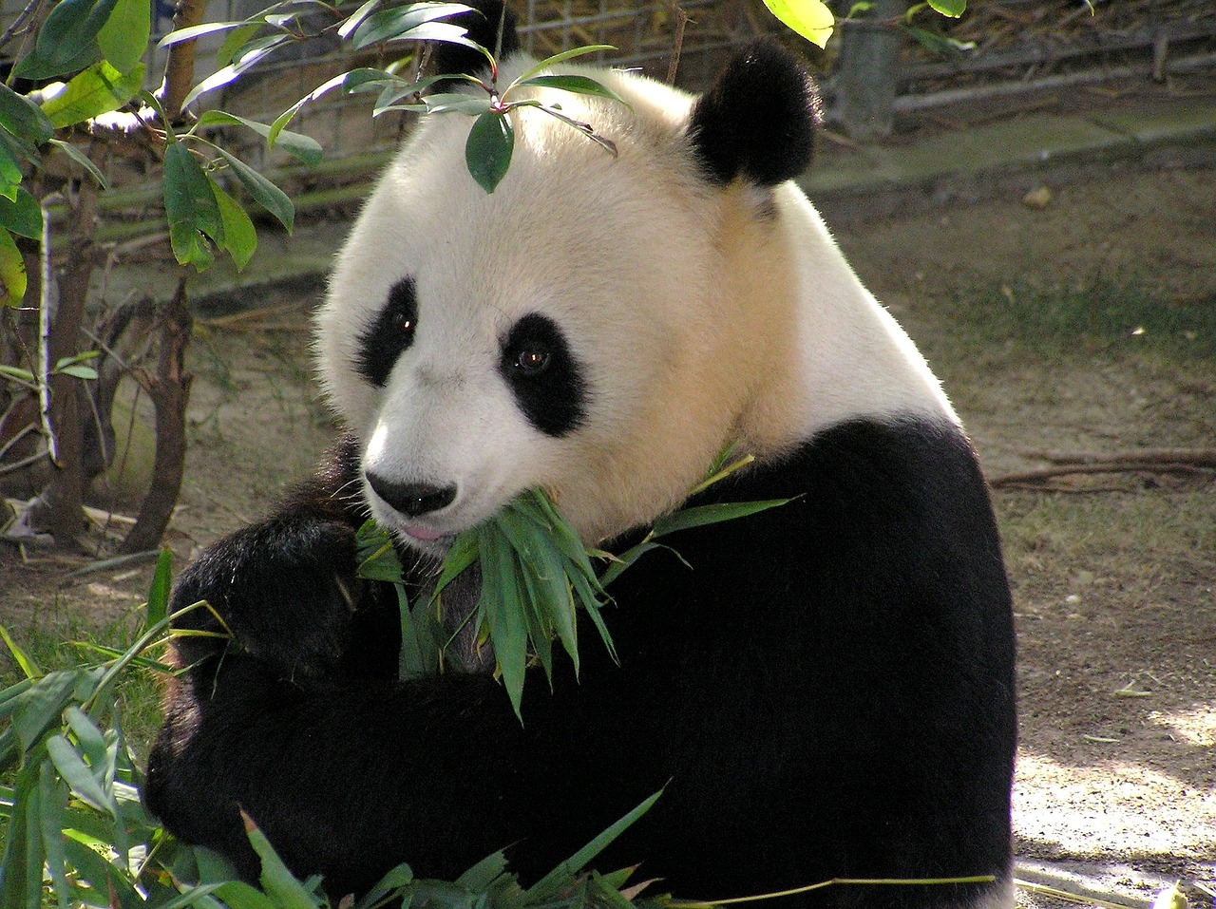
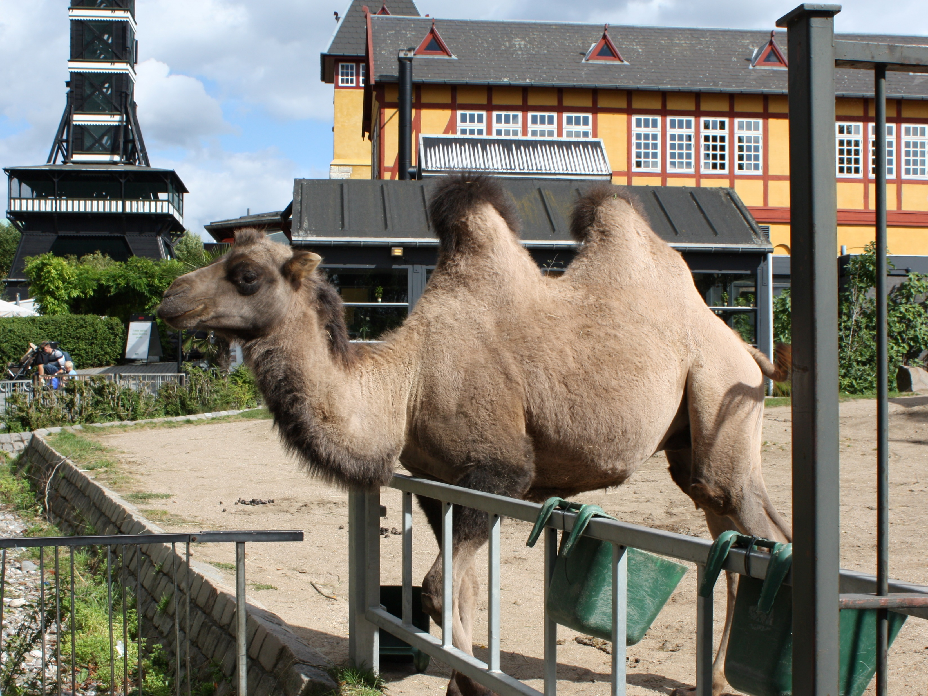
Summary
The project has highlighted critical areas for conservation within national parks.
Key points include:
The current state of biodiversity and identified trends
Recommendations for improving species diversity and habitat quality
The importance of continued monitoring and community involvement
Next steps involve implementing conservation actions and further research to track progress and adapt strategies.
This Photo by Unknown Author is licensed under CC BY-SA

Slide 8
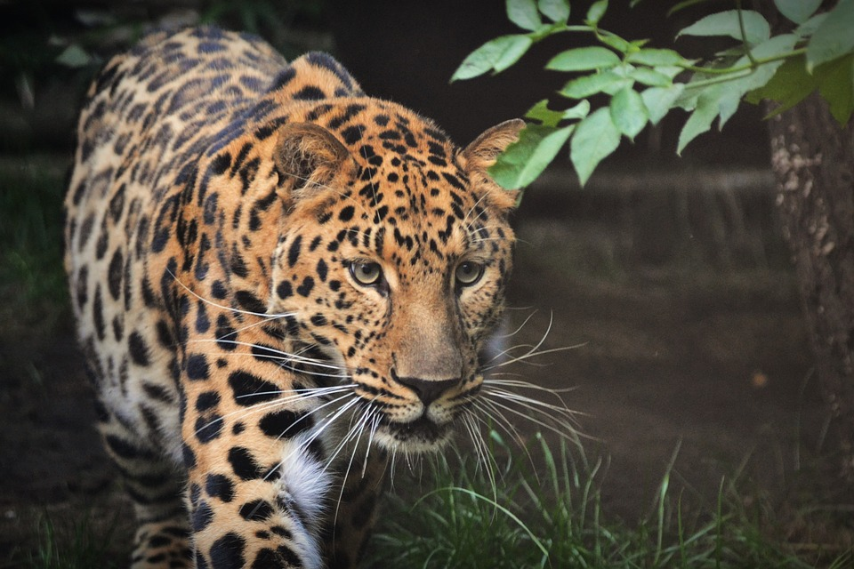

Thank you
PANKAJ TYAGI
sujaltyagi7788@gmail.com

